Slide 1
Hopping, Stopping, and Shopping the Train Part 3
Se mettre à bord, faire stopper et maganiser le train 3e partie
Comment les premières nations achetent les chemins de fer et les font marcher pour le bien commun
How First Nations and buying up
Railways and making them work

Slide 2
INTRO TO TEACHERS AND STUDENTS
In the last decade, most discussion of First Nations and railways has been on the impact of the coming of the steel on peoples who were here before. This was a needed pause to celebration of so-called “civilization.” (Gandhi)
Amidst the earlier self-congratulation, some historians tried to balance the books, pointing out the human costs of development. They noted Louis Riel, who led a revolt of his people, ended up saving CPR from collapse in 1885.
Indigenous words for the rail technology proved prophetic. For the Siksika, a locomotive was a demon with a glaring eye and voracious appetite for coal and water. To the Pikani, the train was a snake, slithering over the land.
A new chapter began as First Nations buy up and operate regional railways for the benefit of their communities and the kanata constellation. This is an opportunity for us to see what they can teach us “along the right-of way.”

Slide 3
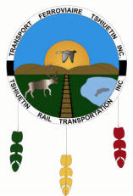
Three regional Canadian railways of 200 km or more are First Nations owned in whole or part. All connect with oceans: the Atlantic (Gulf of Saint Laurence) the Arctic (Hudson Bay) and the Pacific (Salish Sea).
Trois chemins de fer régionaux appartiennent en tout ou en partie aux Premières Nations. Chacun relie à un océan: l’Atlanqique (la Golfe du St-Laurent), l’Arctique (la Baie d’Hudson) et la Pacifique (la Mer des Salish).

Slide 4
This is an optional, self-study module for those who have done “Hopping”/“Stopping the Train”
Celui-ci est un module d’ étude optional pour ceux/celles qui ont déjà fait ceux de “Monter à bord” et “Stopper le train”
Students, parents, and teachers who’ve taken the earlier two modules at Classroom On Rails are welcome to share their work on this unit for
comment and evaluation
posting on CCOR online page
Les étudiant(e)s, les parents et les enseignant(e)s qui ont achevé les deux modules précédents sont invites à partager leurs travaux sur ce module-ci pour les buts de
commentaire ainsi qu’évaluation
poster à la page en ligne de S-Cla-Ferro-Can

Slide 5
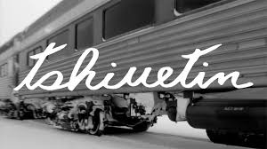
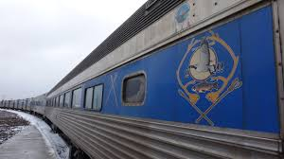
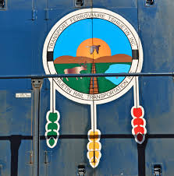
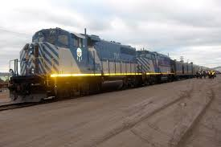
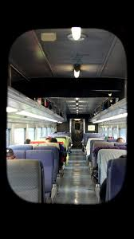
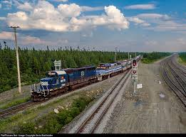
Tshiuetin Rail Transport operates over the Quebec, North Shore and Labrador (QNSL) line
Teansport Ferroviaire Tshiuetin exploite la voie ferrée reliant Emeril NL a Schefferville QC

Slide 6
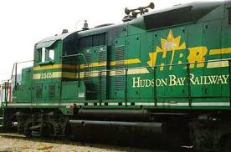
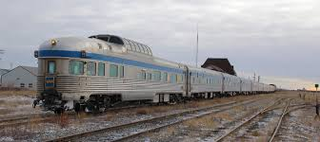
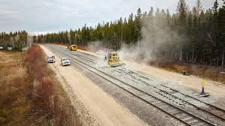
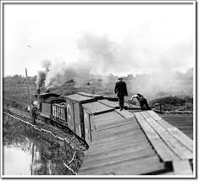
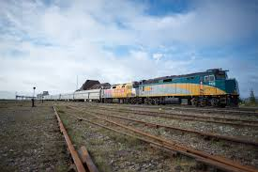
The Hudson Bay Railway branches off the CN mainline and runs to Churchill, Manitoba
Le Chemin de fer de la Baie d’Hudson relie la ligne principale du CN à Churchill MB
Hudson Bay Railway: Fostering Regional Prosperity with Indigenous and Community-Driven Values

Slide 7
The Vancouver Island Corridor Foundation owns the former Esquimalt & Nanaimo Railway (E&N)
La Fondation du Couloir de l’ÎIe de Vancouver est propiétaire de l’ancien Esquimalt & Nanaimo Railway
The Corridor is joinlty owned by First Nations and municipalities it passes through
Rail traffic last ran the full length of the line in 2011. There are plans to revive all of parts of the line.

Slide 8
There are other shorter Indigenous owned/ operated lines in Canada’s mainland provinces
Quelques-uns tansportent les marchandises.
Quelques-uns offrent les services aux voyageurs.
Quelques-uns sont les “exploitations de gare” pour entreposage et le réparrage des wagons et les locomotives
D’autres offrent un combi-naison de ces servicds.
Il y a d’autres chemins de fer dirigés par les peuples autochtones aux provinces et térrestres canadiens.
Some of these are freight carrieirs
some run passenger excursions
some are “terminal operations” to store and repair railcars/locomotives and some offer a mix of these services

Slide 9
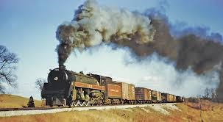
OVERVIEW / sur-vol
To complete this unit, you will:
study one of the two operating Indigenous railways in Slide … using the questionnaire outline next slide
study another short line close to home, in your province or territory a neighbouring province or territory
Pour achiever ce module, vous devrez:
faire une étude sur un de deux chemins de fer Autochtones nommés au troisième diapositive et
rechercher une autre “ligne courte” plus près de chez vous

Slide 10
QUESTIONNAIRE / OUTLINE FOR YOUR STUDY of… (name of line)
Kind of line (passenger, freight, industrial terminal, mixed traffic)
Where it runs (from / to)
Who owns it (whole / part)?
How long have they owned it?
Other lines it connects with
Numbers Questions/stats
Line length in miles/kilometers: how much mainline, yard/sidings
How many staff (on line, in office)
How many trains/week does it run
How many carloads/year (freight)
How many locomotives/cars does it own or lease

Slide 11
How to go about your study (method)
First hand: IDEAL – If you know someone who works on the line, start there.
Online – Google search, by company name if you know it, or list of railways by province
Hard copy prospectus at library (phone beforehand) or request to have sent by mail
Combined – build a list of questions from your research; use it for a phone / ZOOM interview
Compare and Contrast information you’ve gathered from these different sources.

Slide 12
Program material developed by © Canadian Specific Enterprises, a subsidiary of Canadian Classroom on Rails Experience (CCOR)
Ressources programmatiques © Entreprises Canadienne Spécifique, une initiative de la Salle de Classe ferroviaire canadienne (S-Cla-Ferro-Can)

